Slide 1
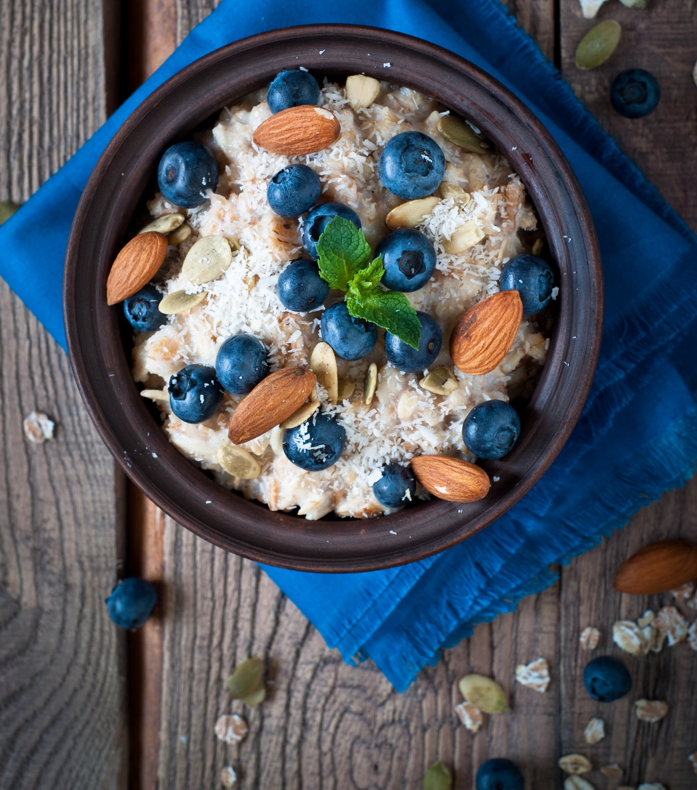
150
calories
Oatmeal with blueberries and almonds

Slide 2
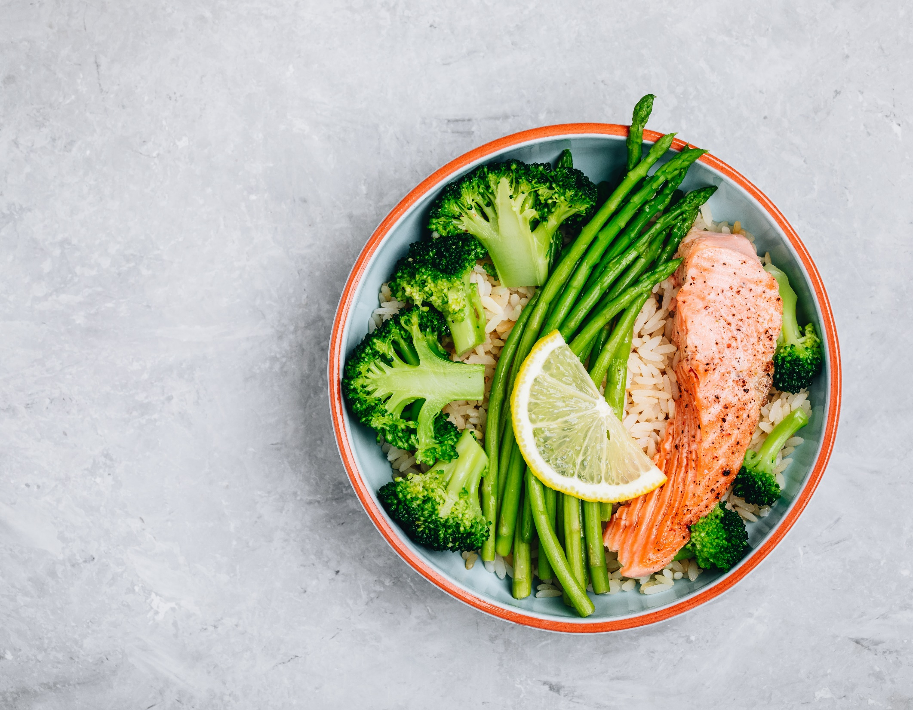
375
calories
Salmon, brown rice, and asparagus

Slide 3
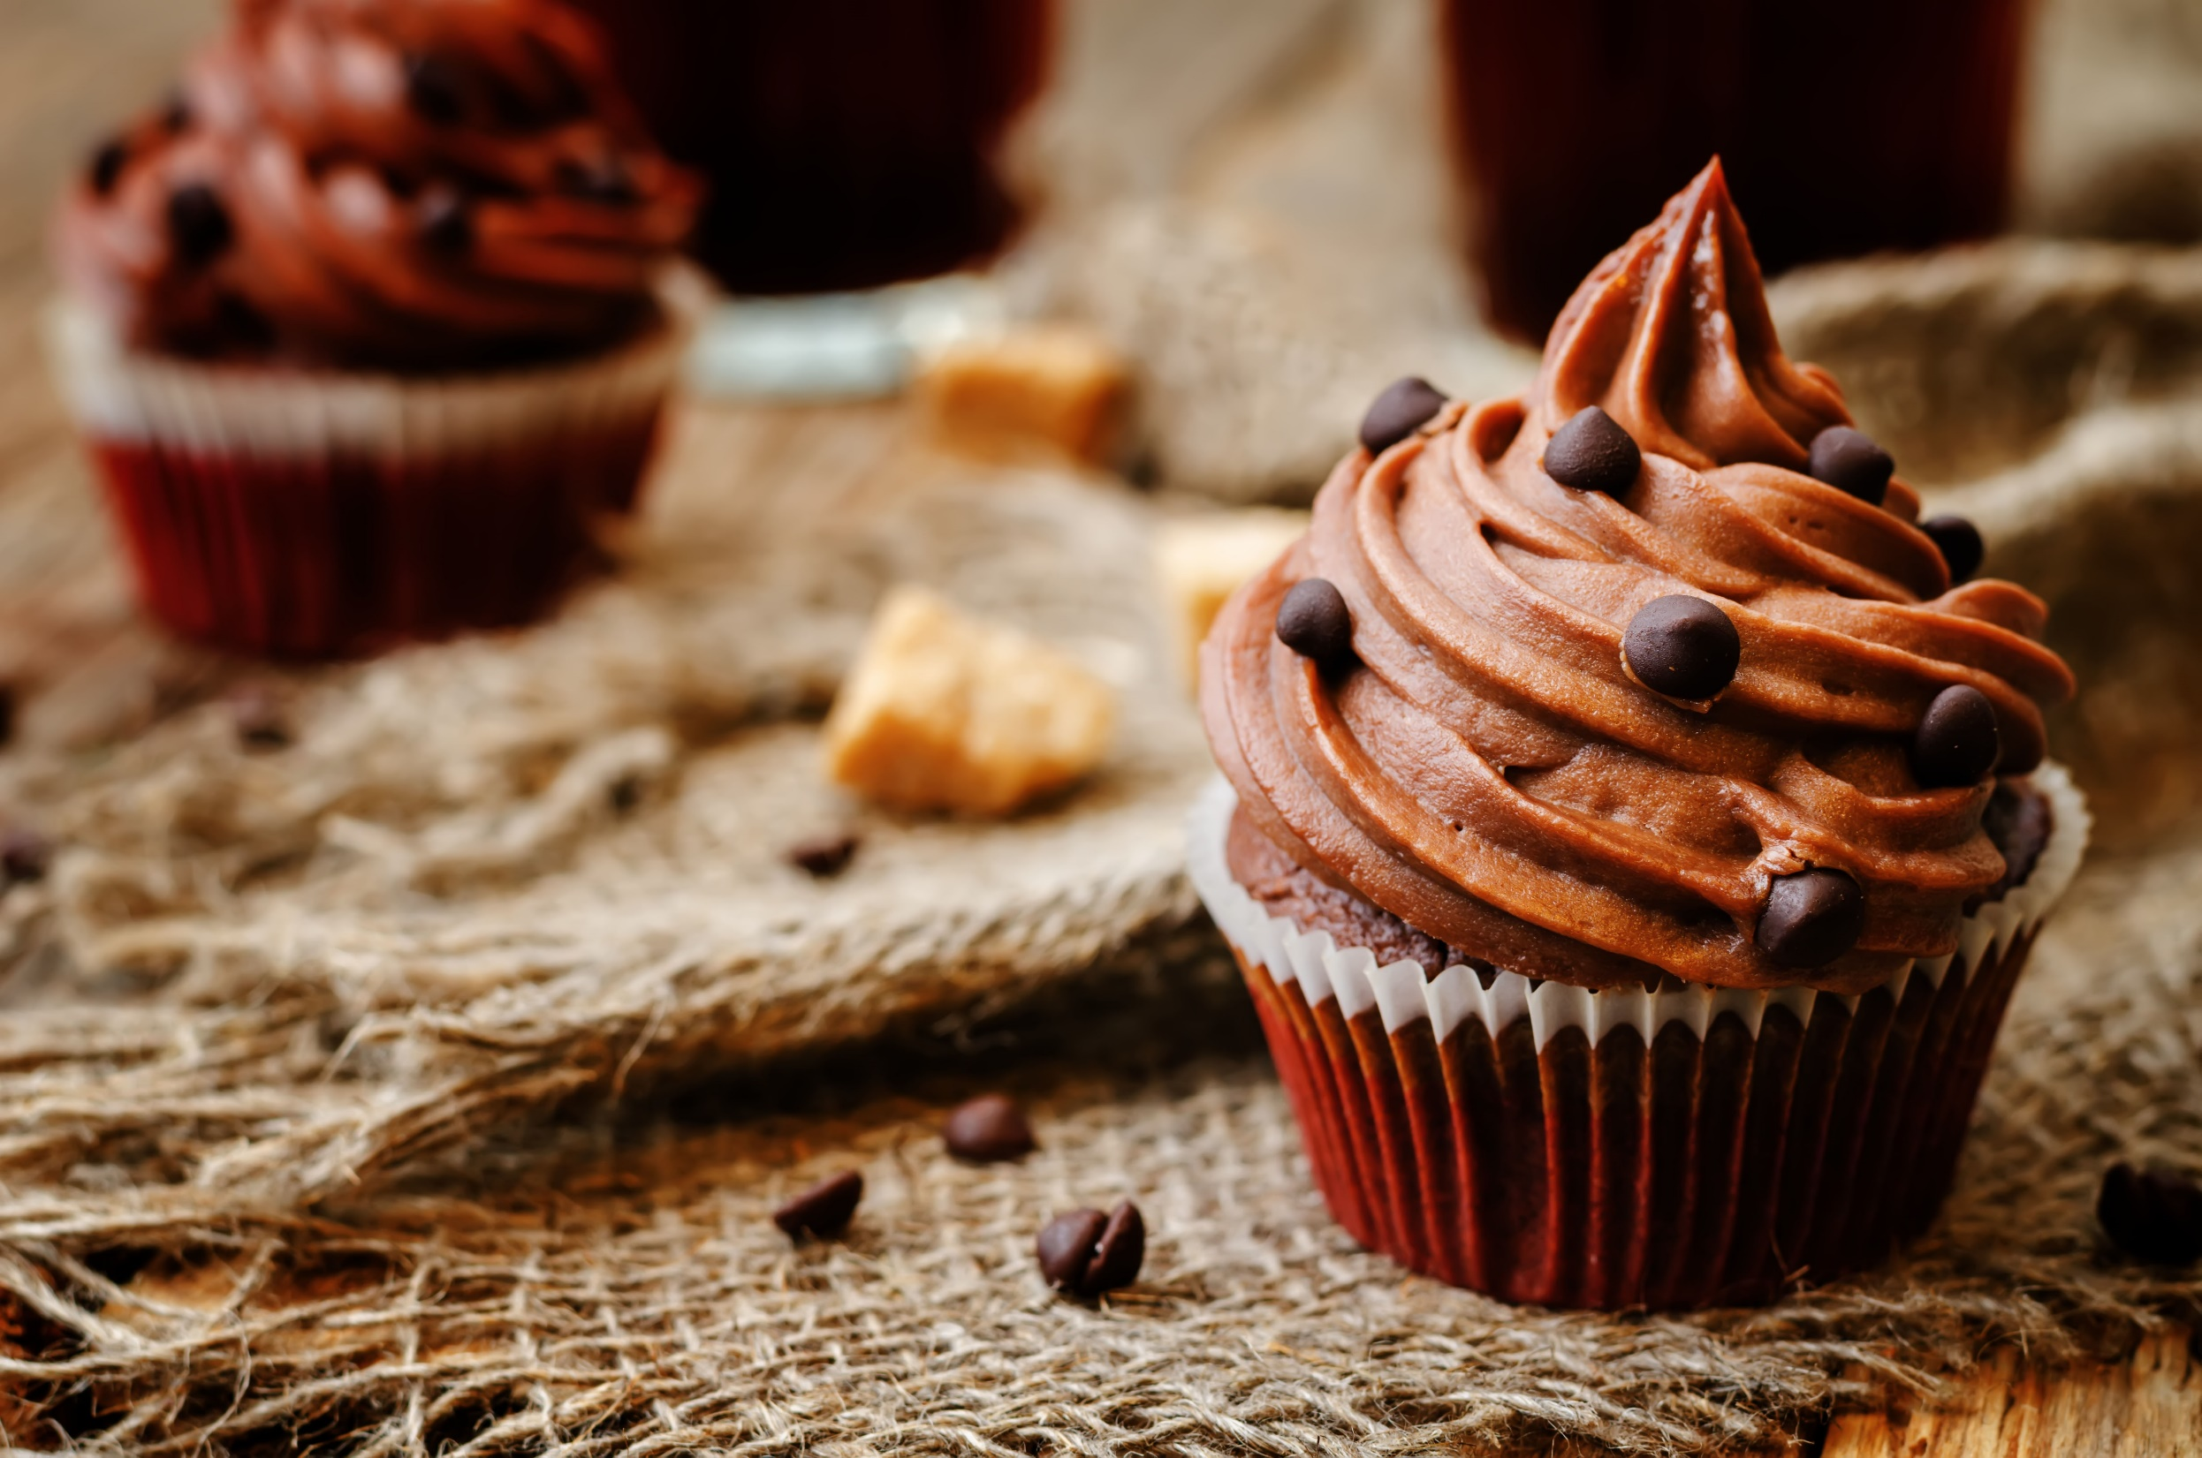
200
calories
Chocolate cupcake

Slide 4
Oatmeal with blueberries and almonds
150
calories

Slide 5
Salmon, brown rice, and asparagus
375
calories

Slide 6
Chocolate cupcake
200
calories

Slide 7
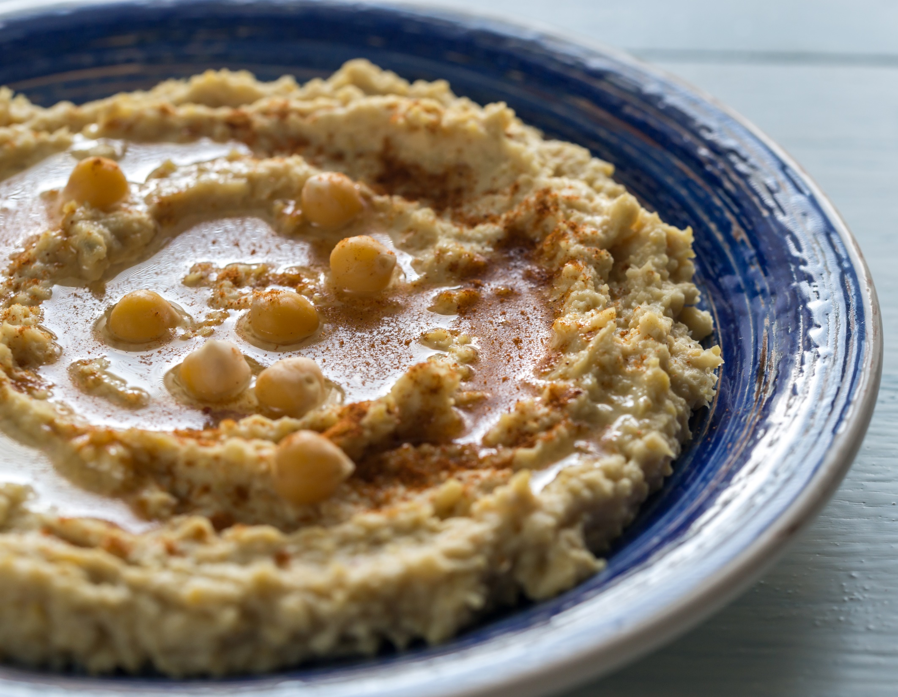
100
calories
Hummus and baby carrots

Slide 8
Hummus and baby carrots
100
calories

Slide 9
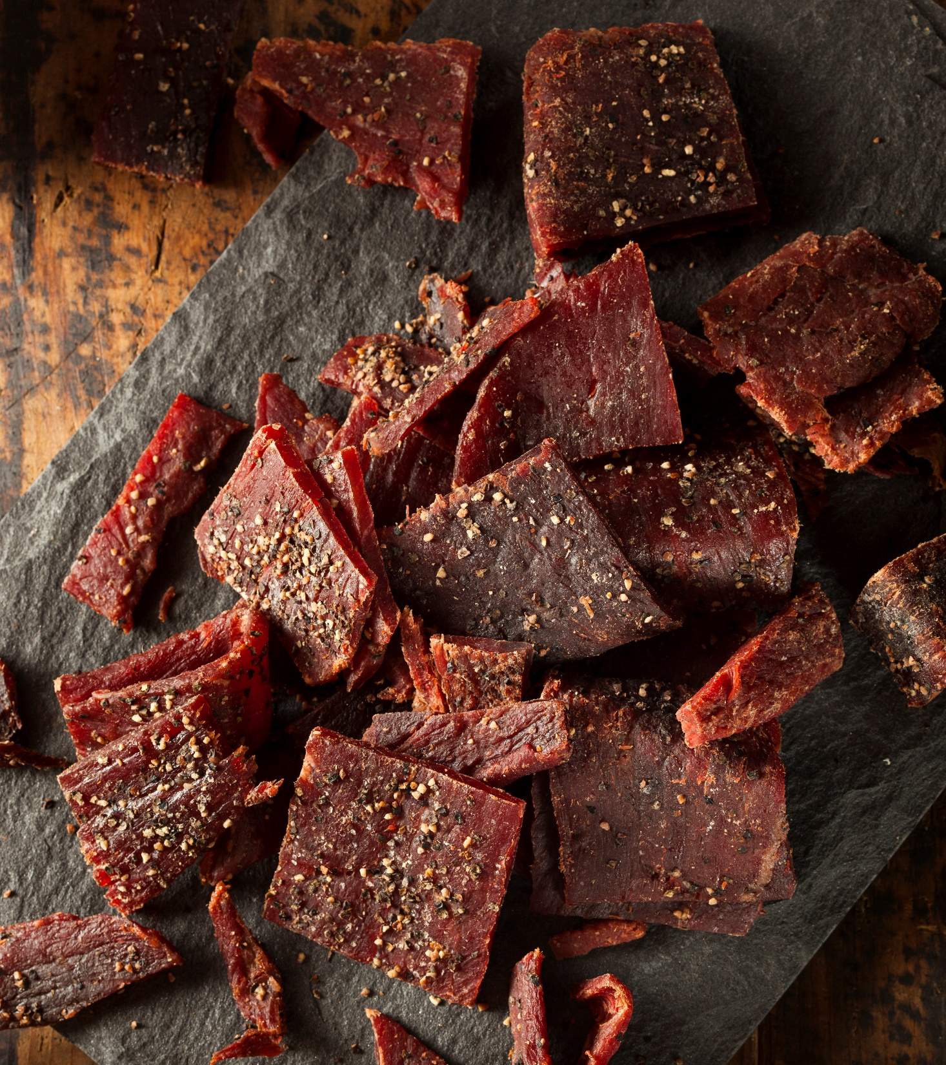
80
calories
Jerky

Slide 10
Jerky
80
calories

Slide 11
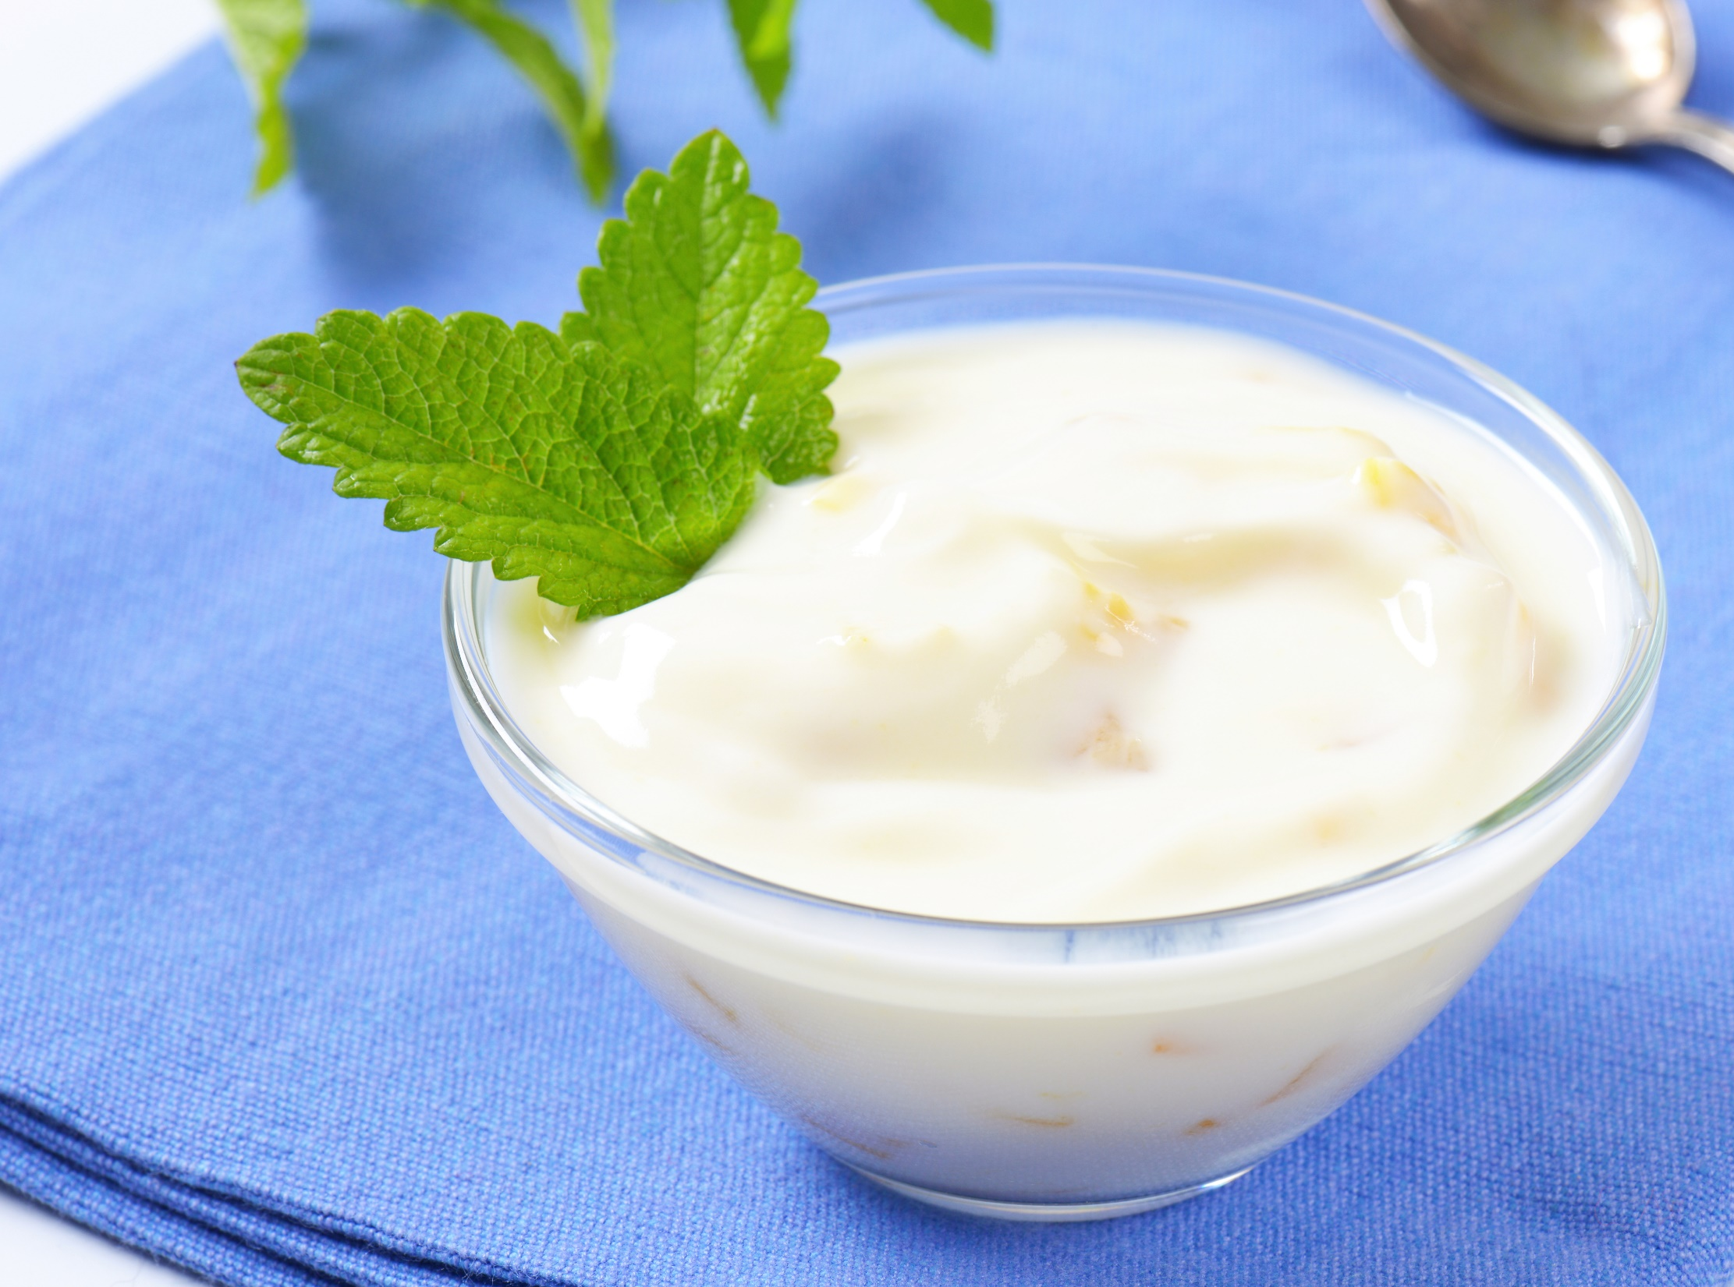
125
calories
Greek yogurt with peaches

Slide 12
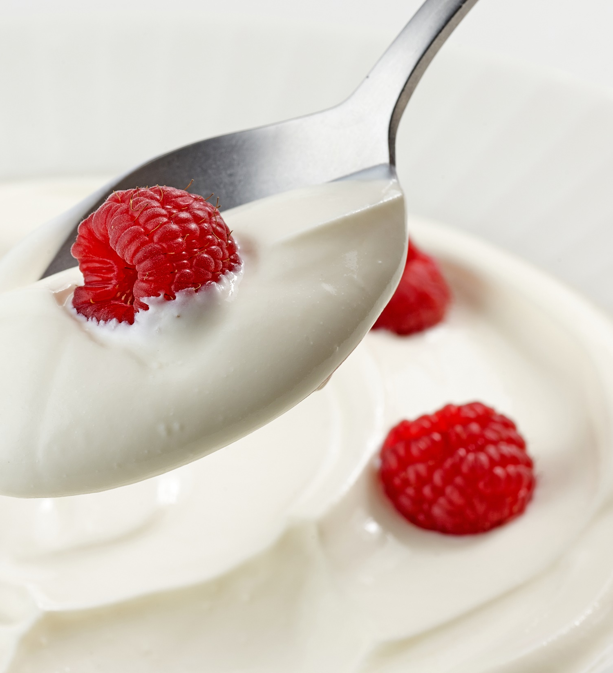
105
calories
Greek yogurt with raspberries

Slide 13
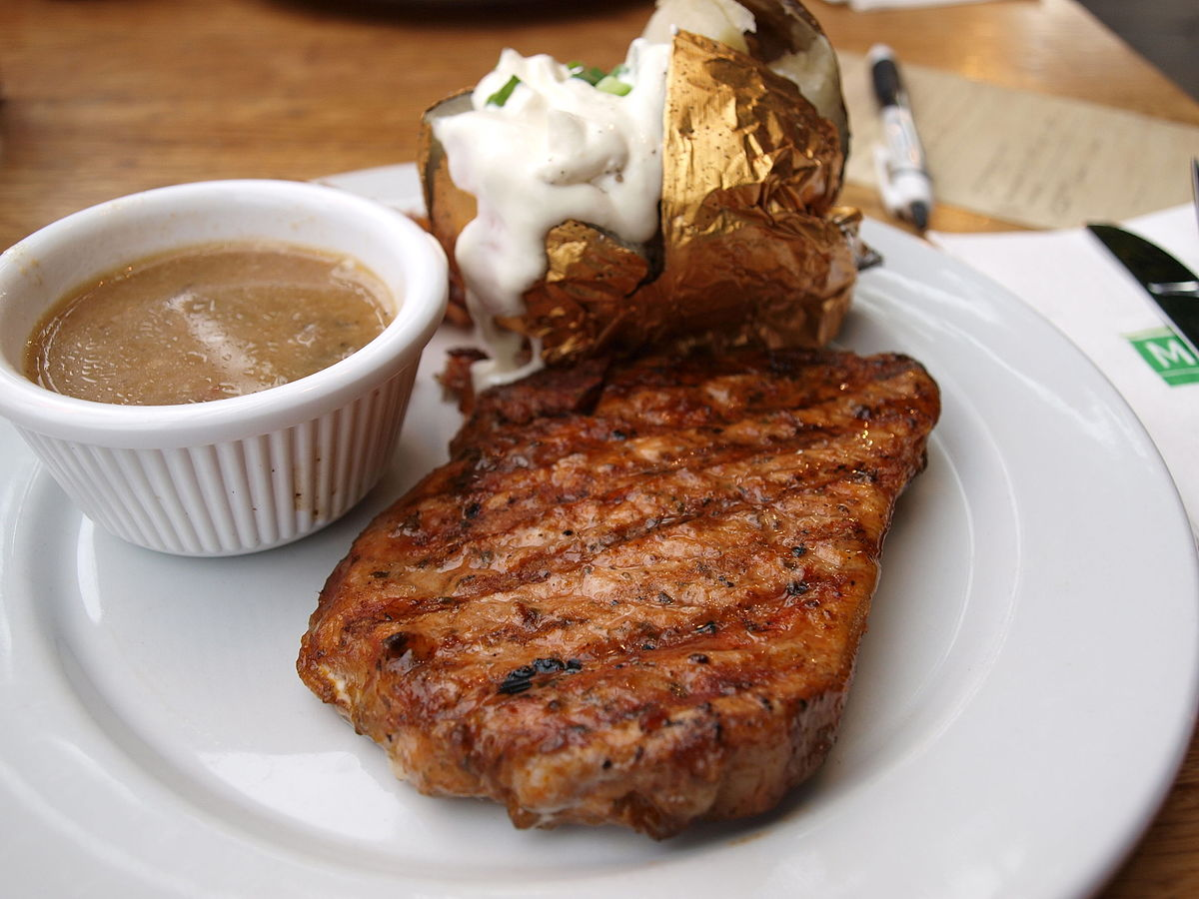
550
calories
Steak, baked potato, salad, and roll

Slide 14
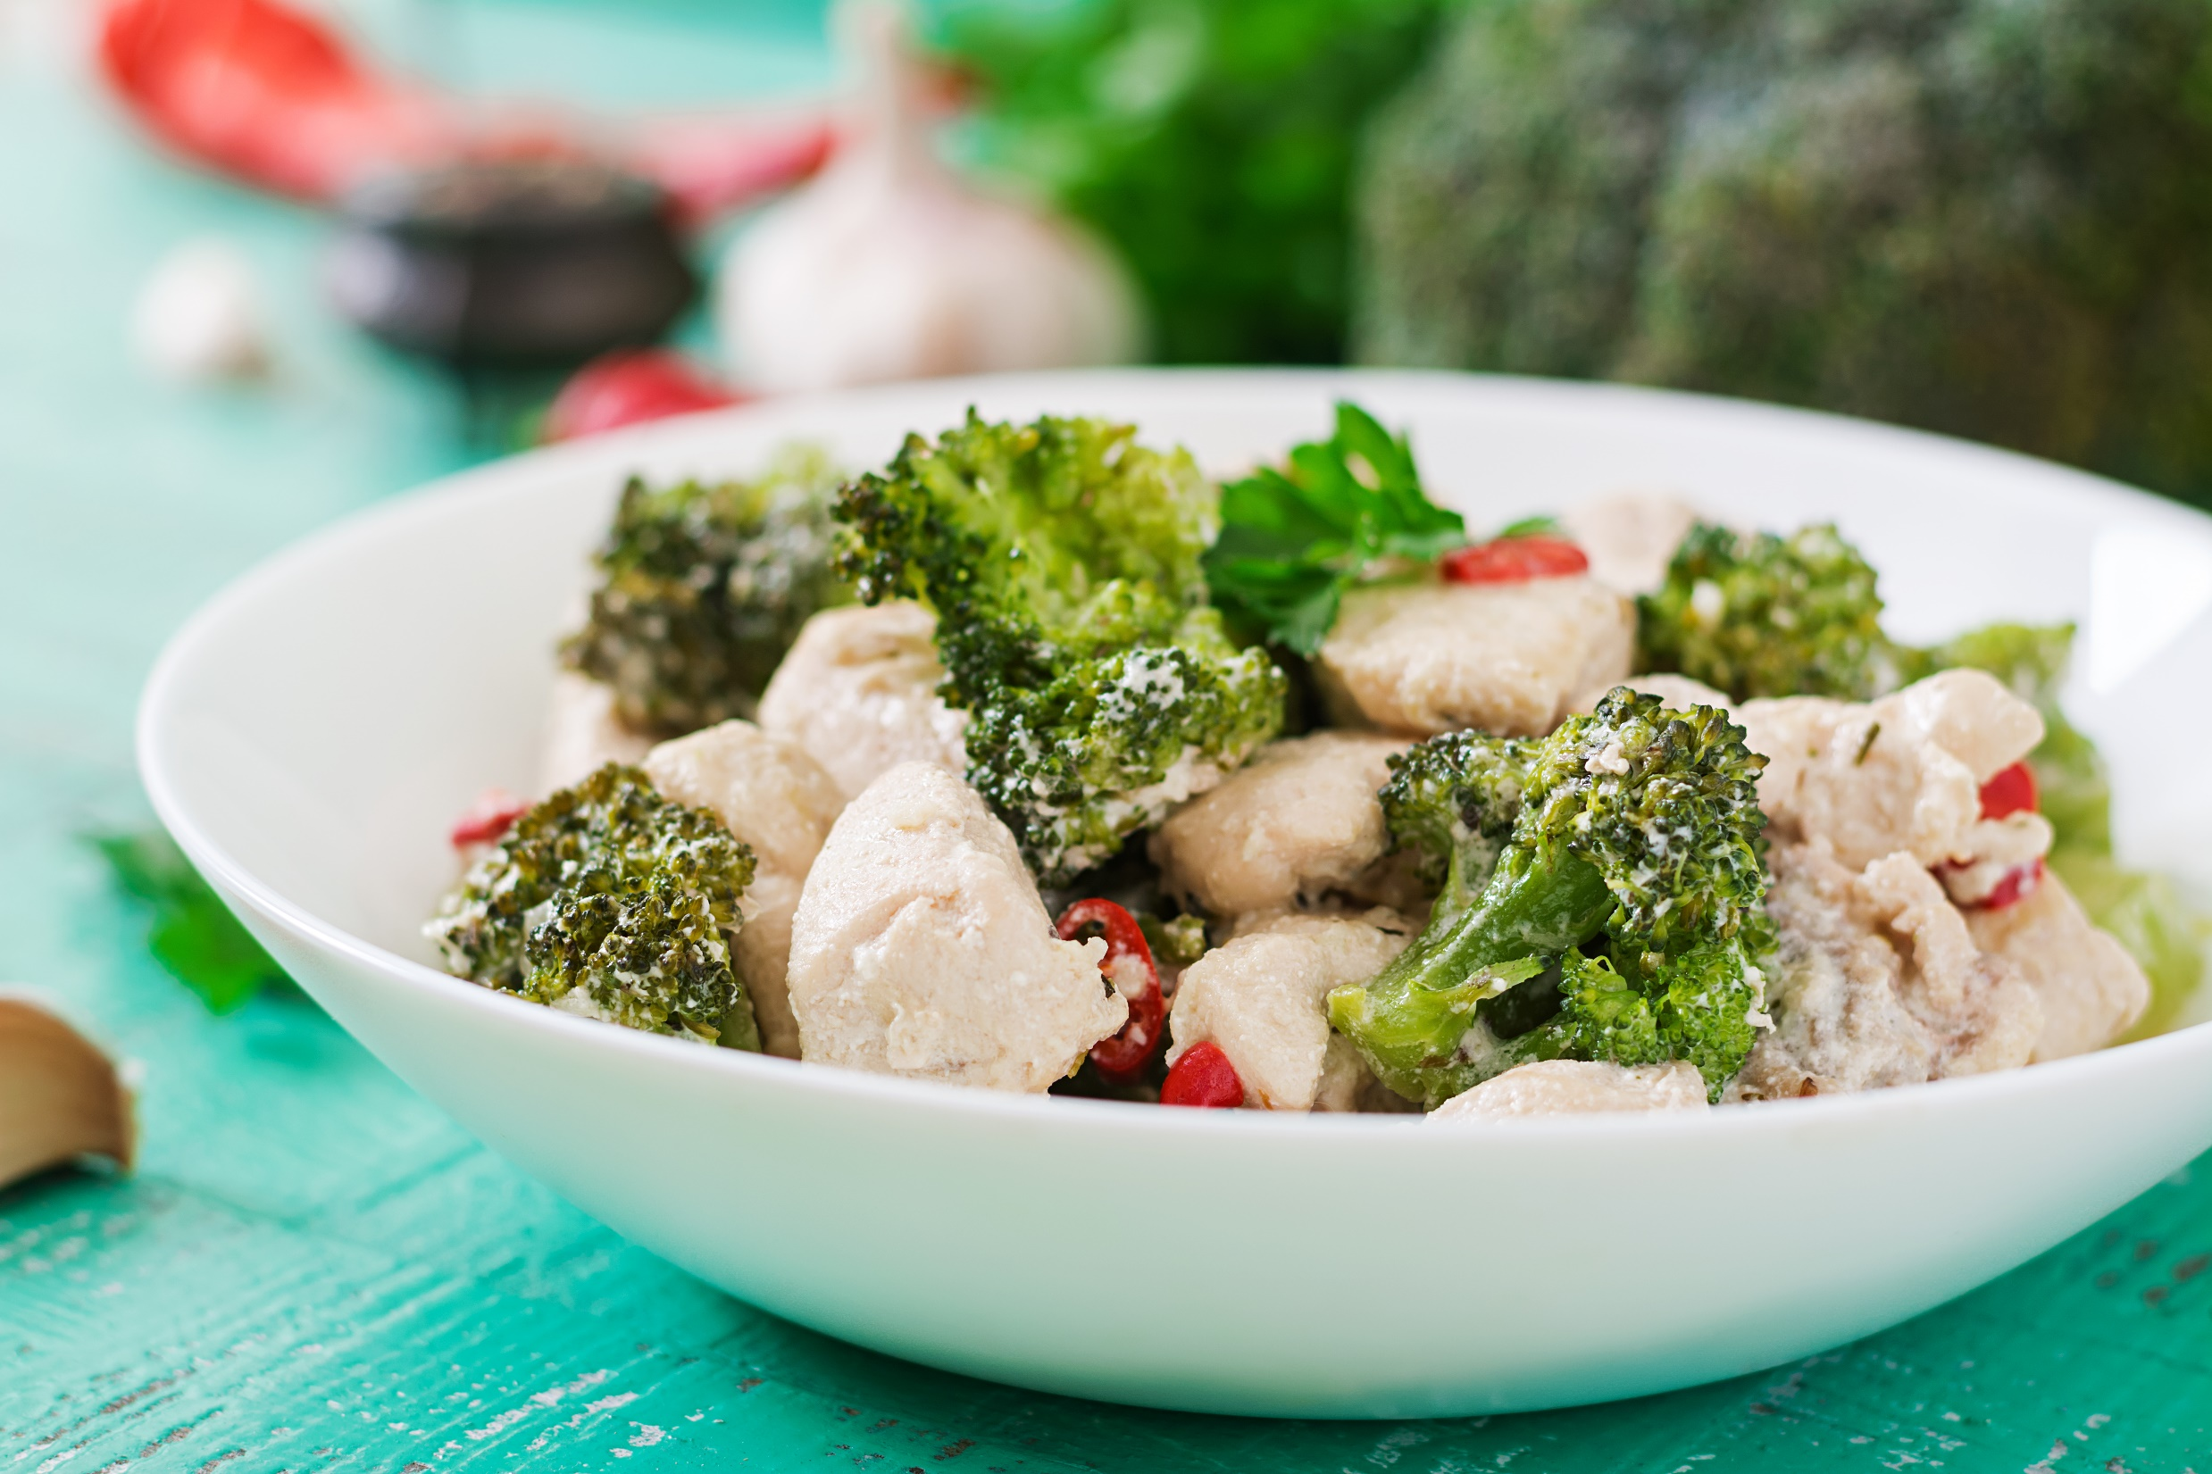
250
calories
Chicken and broccoli in garlic sauce

Slide 15
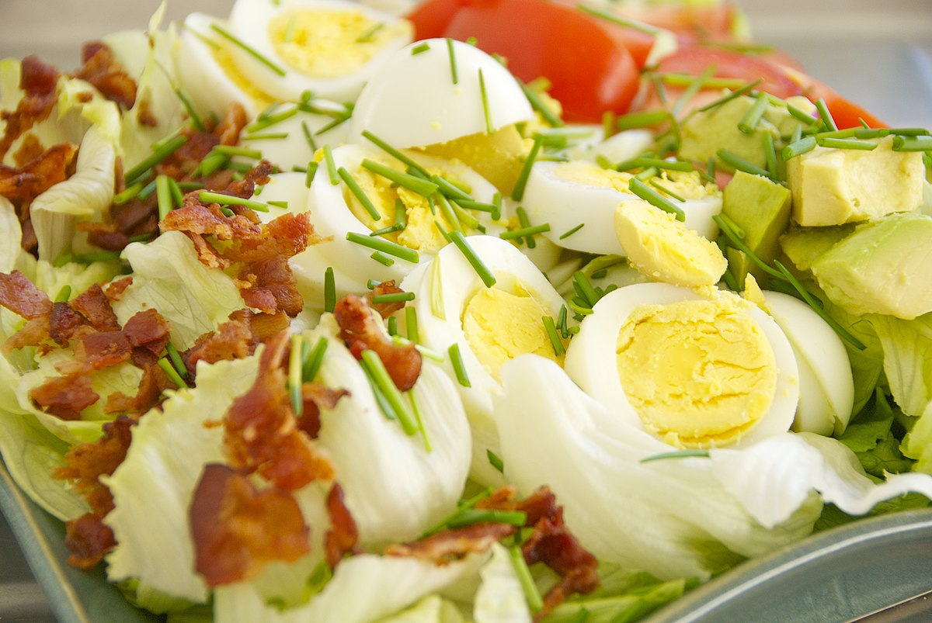
300
calories
Cobb salad

Slide 16
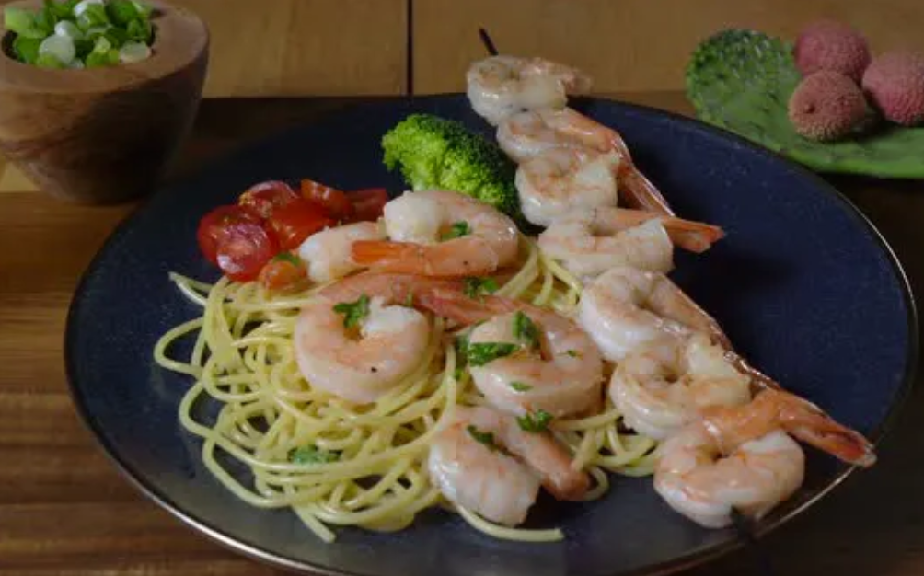
420
calories
Shrimp scampi

Slide 17


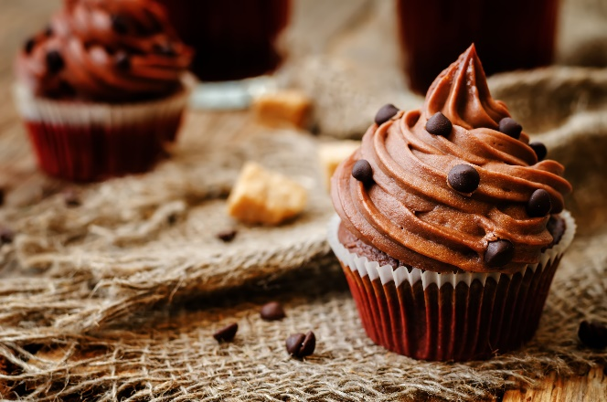
Afternoon snack
Dinner
800
calories
Bedtime snack

Slide 18
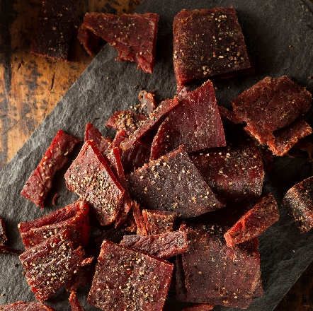
Dinner
880
calories
Bedtime snack

Slide 19

1150
calories
Bedtime snack

Slide 20

1275
calories

